Slide 1
Antiemetic Prophylaxis for Chemotherapy Induced Nausea and Vomiting (CINV)
Dr. Yana Hasan

Slide 2
Today’s Outline
• Pathophysiology and Pharmacology of CINV
• Drugs and definitions
• CINV risk factors
• Guidelines for CINV
• Conclusion

Slide 3
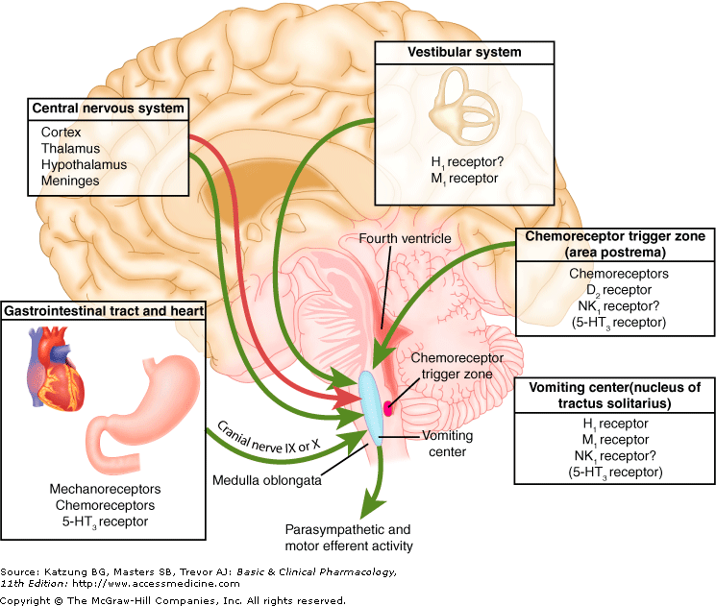
Pathophysiology Review

Slide 4
Pathophysiology Review

Slide 5
CINV-Definition
acute
delayed
Minutes to hours following chemotherapy
Chemotherapy classified by risk
Patient risk factors
Schedule prophylactic medications
Utilize other agents/mechanisms
Occurs despite prophylaxis
breakthrough
Approximately 20% of patients
anticipatory
More than 24 hrs after chemotherapy
More common with:
Carboplatin
Cisplatin
Cyclophosphamide
Doxorubicin
/PRN/ medication
that is a learned reflex response an -triggered by sights, sounds, or smells - predicated on the development of CINV following prior therapy

Slide 6
CINV Risk Factors: Patient-Specific
Assess for level of patient risk :
- Young age < 50
- Female
- Non-alcohol drinker
- History of motion sickness
- Those previously failing conventional antiemetic therapy
- Pregnancy-induced nausea/vomiting
- Anxiety, expectation of nausea
- Prior CINV
Anther causes-

Slide 7
CINV Risk Factors: Regimen-Specific
N/V is a dose-related toxicity
• Single-agent chemotherapy risk categories:
– High (>90% incidence in acute and delayed)
– Moderate (30-90% in acute and delayed)
– Low (10-30% in acute)
– Minimal (<10% in acute)
• For multi-drug regimens, the drug that has the highest level of emetogenicity determines the regimen’s emetic risk level

Slide 8
Overall Emetic Risk
Patient Risk Factors
Regimen Risk Factors
Overall Emetic Risk

Slide 9
Emetogenic potential of parenteral anticancer agents

Slide 10
Emetogenic potential of parenteral anticancer agents

Slide 11
Emetogenic Potential Of Oral Anticancer Agents

Slide 12
Main drugs for today’s discussion
• Corticosteroids:
– Dexamethasone
• Serotonin receptor antagonists (5HT3 RA):
– Dolasetron – Ondansetron – Granisetron – Palonosetron
• Neurokinin-1 (NK1) receptor antagonists :
– Aprepitant – Fosaprepitan

Slide 13
Main drugs for today’s discussion
• Histamine (H1):
– Diphenhydramine – Promethazine – Prochlorperazine
• Muscarinic acetylcholine receptors (M):
– Scopolamine – Diphenhydramine – Promethazine
• Dopamine (D2):
– Haloperidol – Metoclopramide – Olanzapine – Prochlorperazine – Promethazine
• Cannabinoid (CB):
– Dronabinol – Nabilone
• GABA :
– Lorazepam

Slide 14
Chronologic Overview of Key Drug Approval Studies, Food and Drug Administration (FDA)Approvals, and Guideline Development.

Slide 15
Single-day Chemotherapy: Prophylaxis Principles
day4 | day3 | day2 | day1 | Emetic risk
+ | ++ | ++ | +++/+ | high
 | + | + | ++/+ | moderate
 |  |  | + | low
 |  |  |  | minimal

Slide 16
Guideline Recommendations: High Emetogenicity, Acute
• Day 1 of single-day regimen
NCCN3 | ESMO/MASCC2 | ASCO1 | Drug
yes | yes | yes | NK1 RA
yes | yes | yes | Dexamethasone
Yes-palonosetron preferred | yes | yes | 5HT3 RA
Olanzapine instead of NK1 RA |  |  | Alternate regime
• Lorazepam • H2 blocker, PPI |  | • Lorazepam •Diphenhydramin | Others supportive care

Slide 17
Guideline Recommendations: High Emetogenicity, Delayed
• Days 2 through 4 of single-day regimens
NCCN3 | ESMO/MASCC2 | ASCO1 | Drug
Days 2-3 | Days 2-3 | Days 2-3 | NK1 RA
Days 2-4 | Days 2-4 | Days 2-3 or Days 2-4 | Dexamethasone
No (palonosetron preferred | No | No | Alternate regimen
Olanzapine instead of NK1R
• Lorazepam • H2 blocker, PPI |  | • Lorazepam •Diphenhydramine | Other supportive care

Slide 18
Guideline Recommendations: Moderate Emetogenicity, Acute
• Day 1 of single-day regimens
NCCN3 | ESMO/MASCC2 | ASCO1 | Drug
May add | No | May add | NK1 RA
12 mg | 8 mg | 8 mg | Dexamethasone
Yes (palonosetron preferred) | Yes - palonosetron | Yes - palonosetron | 5HT3 RA
Olanzapine + 5HT3 RA + Dex |  |  | Alternate regimen
• Lorazepam • H2 blocker, PPI |  | • Lorazepam •Diphenhydramine | Other supportive care

Slide 19
Guideline Recommendations: Moderate Emetogenicity, Delayed
• Days 2 through 3 of single-day regimen
NCCN3 | ESMO/MASCC2 | ASCO1 | Drug
Consider one: •Nothing if palonosetron used in acute • NK1 RA +/- dex if used in acute • Dex days 2-3 | No | May add | NK1 RA
 | Days 2-3 | Days 2-3 | Dexamethasone
 | No (palonosetron preferred) | No (palonosetron preferred) | 5HT3 RA
Olanzapine |  |  | Alternate regimen
• Lorazepam • H2 blocker, PPi |  | • Lorazepam •Diphenhydramine | Other supportive care

Slide 20
Dosing Scenarios

Slide 21
Dosing Scenarios

Slide 22
Dosing Scenarios
• High Emetogenicity Chemotherapy (HEC)
• Moderate Emetogenicity Chemotherapy (HEC)
• PRN for breakthrough required through all days
• Consider lorazepam and acid suppression
Day4 | Day3 | Day2 | Day1
No further dosing needed |  |  | Fosaprep 150 mg IV | NK1 RA
8 mg PO | 8 mg PO | 8 mg PO | 12 mg IV | Dex
No | No | No | Yes | 5HT3 RA
Day4 | Day3 | Day2 | Day1
 | No | No | No | NK1 RA
 | 8 mg IV/PO | 8 mg IV/PO | 8 mg IV/PO | Dex
 |  |  | Palonosetron 0.25 mg IV | 5HT3 RA

Slide 23
CINV: Low and Minimal
• Low
• Minimal
– No routine prophylaxis
NCCN3 | ESMO/MASCC | ASCO1
Dexamethasone -OR- 5HT3 RA -OR- Dopamine RA (metoclopramide, prochlorperazine -OR- 5-HT3 RA : | Dexamethasone -OR- 5HT3 RA -OR- Dopamine RA (metoclopramide, prochlorperazine | Dexamethasone 8mg | Administer one dose before chemo Reapet daily for multiday doses

Slide 24
Multiday Chemo Scenario

Slide 25
Anticipatory emesis Prevention/Treatment
- Prevention is key:
*use optimal antiemetic therapy during every cycle of treatment
*Avoid strong smells that may precipitate symptoms
-Behavior Therapy:
yoga/ music /relaxation exercises
- Acupuncture
-consider anxiolytic therapy:
Lorazepam 0.5-1 mg at night before chemotherapy and then repeat the
next day 1-2 h before treatment

Slide 26
Breakthrough Treatment For CIVN

Slide 27
Something for PRN (Breakthrough)
• Attack a different receptor
– Prochlorperazine 10 mg IV/PO Q6 hr PRN
– Metoclopramide 10-40 mg IV/PO Q4-6 hr PRN
– Promethazine 12.5-25 mg IV/PO Q4 hr PRN
– 5HT3 dosing varies (just make sure it’s not above the max recommended dose per day)
– Haloperidol 0.5-2 mg PO Q4-6 hr PRN
– Dronabinol 5-10 mg PO Q3-6 hr PRN
– Nabilone 1-2 mg PO BID PRN
– Dexamethasone 12 mg PO/IV daily if not already given
– Olanzapine 10 mg PO daily for 3 days

Slide 28
Subsequent Cycles Of Chemotherapy

Slide 29
Antiemetic Treatment Recommendations for Emetogenic Intravenous Chemotherapy

Slide 30
Radiation induced Emesis Prevention/Treatment

Slide 31
Clinical Question
. Should current guideline-endorsed antiemetic regimens that include dexamethasone be modified when checkpoint inhibitors are incorporated in antineoplastic treatment regimens?
No definitive data is currently available to prove or disprove this hypothesis.

Slide 32
Discussion
*Chemotherapy-induced nausea and vomiting (CINV) have been consistently demonstrated to be among the most feared adverse effects of cancer treatment
*Corticosteroids, almost exclusively dexamethasone, have been shown to be effective and safe agents for low moderate and highly emetogenic chemotherapy
We can use Olanzipane if dexamethasone is untolarent*

Slide 33
Thank you

